Slide 1

Practical 19
Two Sum using HashMap

Slide 2

Lesson Plan
Subject/Course | Competitive Coding
Lesson Title | Two Sum using HashMap
Lesson Objectives
To use a HashMap for fast element retrieval from an array.
To identify two elements whose sum equals the given target.
To return the indices of the matched pair.
To optimize the solution from O(n²) to O(n) using hashing.

Slide 3
Problem Statement:
Write a program to find two numbers in an array whose sum equals a given target value.

Slide 4
Concept
Why HashMap?
A HashMap stores elements as (key, value) pairs.
We can store each number’s complement (target – num) while traversing the array.
Lookup in HashMap is O(1) → efficient solution.
Applications:
Pair matching problems.
Detecting complement elements in arrays.
Financial or resource allocation checks (sum validation).

Slide 5
Concept
Brute Force:
Check every pair using 2 loops
Time Complexity: O(n²) ❌
Optimized Approach:
Use a HashMap to store values and their indices
Check if target – currentValue exists
Time Complexity: O(n) ✅

Slide 6
Algorithm/Logic
1. Create a HashMap <Integer, Integer>
2. Loop through array elements
3. For each element:
complement = target – current
If complement exists in HashMap → return both indices
4. Else insert element and index into HashMap
5. If no pair found → Print "No Match Found"

Slide 7
Visualization
Example: Array = [2, 7, 11, 15], Target = 9
Step | Current Num | Complement (target - num) | Present in Map? | Map State
1 | 2 | 7 | ❌ | {2=0}
2 | 7 | 2 | ✅ Found | {2=0, 7=1}
Pair found → Indices [0, 1] → Values (2, 7)

Slide 8
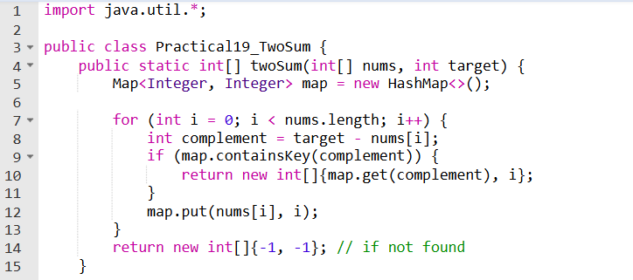
Code Implementation

Slide 9
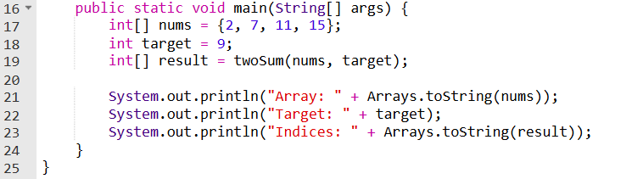

Slide 10
Output
Array: [2, 7, 11, 15]
Target: 9
Indices: [0, 1]

Slide 11
Time & Space Complexity
Time Complexity: O(n) — single pass Space Complexity: O(n) — HashMap storage

Slide 12
Summary
Efficient method to search pair adding up to target
Uses HashMap for instant lookup
Suitable for large inputs
One-pass solution

Slide 13
Summary
✅ Advantage:
Eliminates nested loops
Guaranteed faster performance
📌 Use Cases:
E-Commerce cart matching
Financial security validation
Data search operations

Slide 14
Practice Questions:
1. Two Sum — LeetCode #1
🔗 https://leetcode.com/problems/two-sum/
Concept: Return indices using HashMap
Why Practice: Most frequent interview question

Slide 15
Practice Questions:
2. Implement Queue using Stacks — LeetCode #232
🔗 https://leetcode.com/problems/implement-queue-using-stacks/
Concept: Implement a queue using one or two stacks.
Why Practice: Strengthens your stack understanding by reversing the logic.

Slide 16
Thanks

